Slide 1

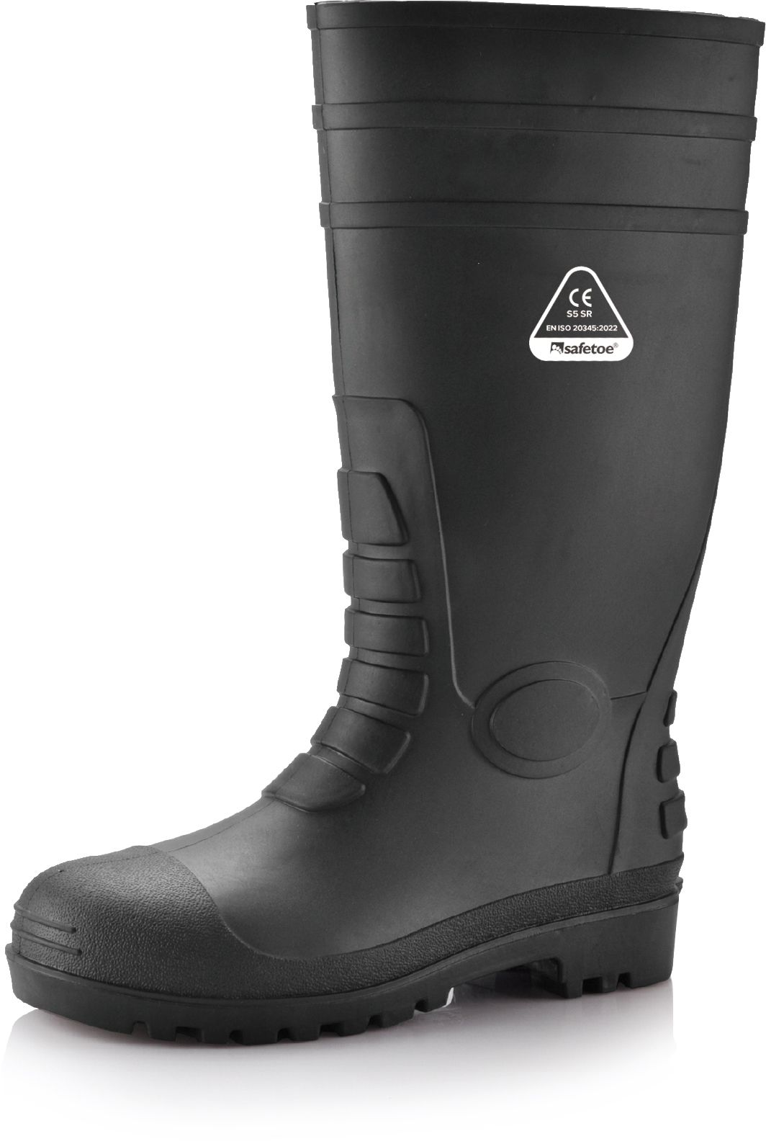









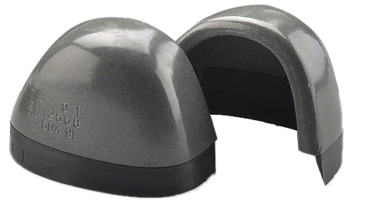
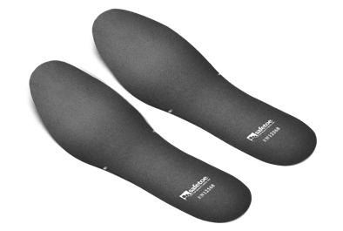


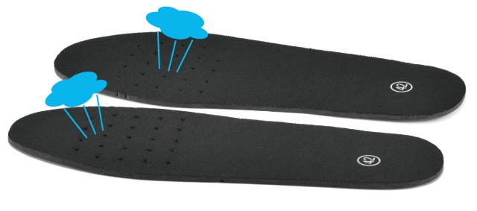

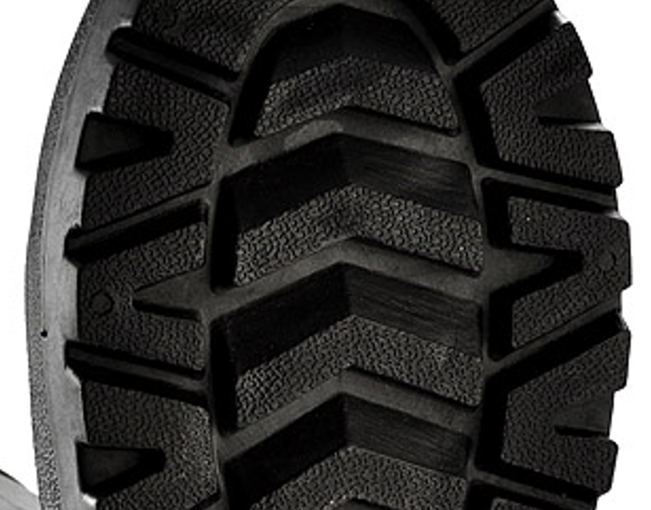
W-6038 S5 (AquaShield)
WELLINGTON BOOTS
Industrial Grade Wellington Boots | CE S5 Certified
Upper : Waterproof PVC (Thickness: 1.8±0.2mm)
Lining : Breathable Mesh Fabric (Quick-Dry)
Insoles: Removable EVA with Arch Support
Outsole : Nitrile-Enhanced PVC Lug Design
Slope Angle: 38° for Mud Shedding
Toecap : VortiGard™ Steel Toecap （200J Impact）
Penetration : VortiGard™ Steel Midsole Plate (1100N Puncture)
Certification: EN ISO 20345:2022 S5 SR (NB:2443)
Height : 38.5cm / 15 inch (Size 42# for reference)
Size : EU 37-47#, UK 3-13#, US4-14#
Application : Construction, Chemical, Food Industry, Catering, Cleaning, Farm & Garden, Food Storage etc
VortiGard™ Steel Toecap Protection • EN ISO 20345:2022
Stainless Steel Toecap is heavy duty and corrosion resistant. The impact resistance can reach 200 joules from falling or rolling objects. The compression resistance can reach 15kN.
EXTRA WIDE
VortiGard™ Steel Plate Protection • EN ISO 20345:2022
Steel midsole plate is flexible and corrosion resistant. The penetration resistance can reach 1100 newtons from nail or other sharp objects. The flex resistance can reach to 1 X 10⁶ flexion cycles without visable cracking.
Breathable & Removable Insoles • EN ISO 20347:2022
Removable EVA Insole provides maximum comfort to your feet and long-stand hours, greatly reduce knee and ankle pressure during walking. The insoles are designed with holes, which is breathable & sweat-absorption.
Slip Resistant Outsole Design • EN ISO 20345:2022
The outsole is made with PVC material, plus 5-10% nitrile. Ultra grip lug design ensures non-slip traction on different workplaces. High density PVC outsole is designed as EN ISO 20345 standard for tear resistant and abrasion resistant.

Slide 2
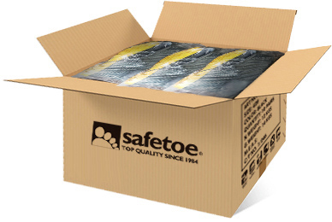
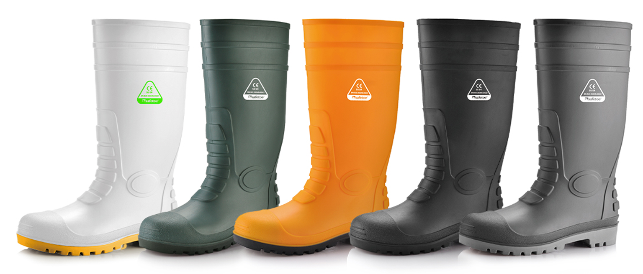
SAFETOE Standard Package Instruction (Average 42# for Reference)
Boots Weight : 1.8~1.9 KGS / Pair | Carton Weight : 19-20 KGS / Carton
1 Pair / Polybag, 10 Pairs / Carton | Carton Dimension : 50×30×50CM
User Instructions:
1.) RECOMMENDED TO USE : Construction, Chemical, Food Industry, Catering, Cleaning, Farm & Garden, Food Storage etc.
2.) LIMITATION TO USE: It is very important that footwear selected must be suitable for the right workplaces. The protection against risks or hazards which are not mentioned in this document is not warranted.
3.) FITTING & SIZE: All footwear are marked with standard size on package. Some are with different size comparation, such as EU size, UK size, US size etc. Please wear footwear in a suitable size. Footwear which are too loose or too tight may not provide optimum level of protection.
4.) STORAGE: Keep the footwear in its original packaging, under ordinary temperature, non-humidity conditions and in clean, covered and ventilated premises.
5.) CLEANING: Clean footwear regularly by high quality cleaning treatments recommended as suitable for the purpose. Don't use caustic or corrosive cleaning agents.
Color Available: Black, Blue, Yellow, White etc

